Slide 1
Workplace Health & Safety
Assessment 1 - VFX
Josh Moten
DUE DATE: 3/4/2019

Slide 2
Introduction
Introduction:
This assessment will examine the process of writing a WHS management plan for a fictional game studio, in line with the provided scenario. The provided brief is designed to collect all the evidence of competency you require for this subject. Following an alternative brief and/or presenting additional evidence of competency needs to be negotiated with your teacher.
The assessment will include:
Analysing a scenario.
Identifying WHS responsibilities.
Conducting hazard and risk assessments.
Implementing WHS control measures.
Evaluating control measures.
Planning WHS Training
Observing and maintaining healthy work practices.
The assessment instructions:
All sections marked in green must be edited/filled out by each student. Be sure to replace “Student Name” on the first slide and include your name in the document filename.

Slide 3
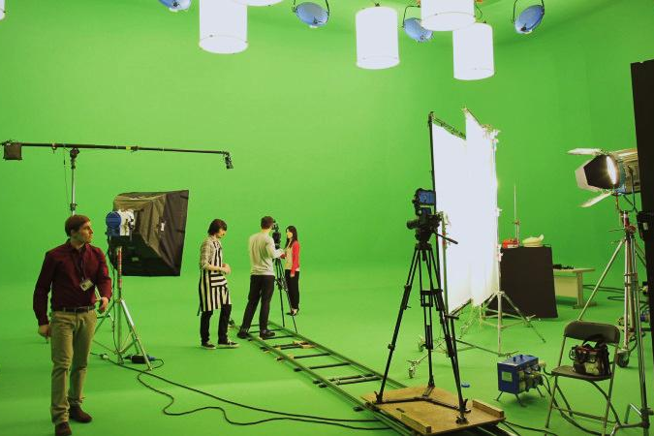
Scenario|Commercial Shoot
Overview:
You have been hired by Catastrophic Productions PTY. LTD., as the Visual Effects Supervisor. Your first job is supervising the shoot of a Television Commercial for a cleaning products company. The client only has the budget for a 1-day shoot, so it will be hard work and a long day (including setup, shooting, and pack up).
The Product is called O.C.D. It’s a general purpose kitchen cleaning spray, not unlike Spray’n’Wipe.
The ad is to be shot in the style of an action film. The actor will be running through a (CG) jungle then jump over a ravine and land in the kitchen ready to save the day by cleaning it.
The ravine and jungle will be composited into the shot in post. It will be shot on a dolly/crane.
The scene will be shot indoors on a green screen sound stage.
As this is a small production, there is no specific person assigned as a safety officer, so you must ensure a safe workplace for all cast and crew involved in the shot.

Slide 4
Health & Safety|Hazard list
As part of a class discussion, list any potential hazards which could arise in the provided scenario.
Mechanical:
Tripping Hazards,
Physical:
Eye strain,
Chemical:
Unsafe cleaning chemicals,
Psychological:
Pressure of Debugging and Setting up event,
Electrical:
Overloading,

Slide 5
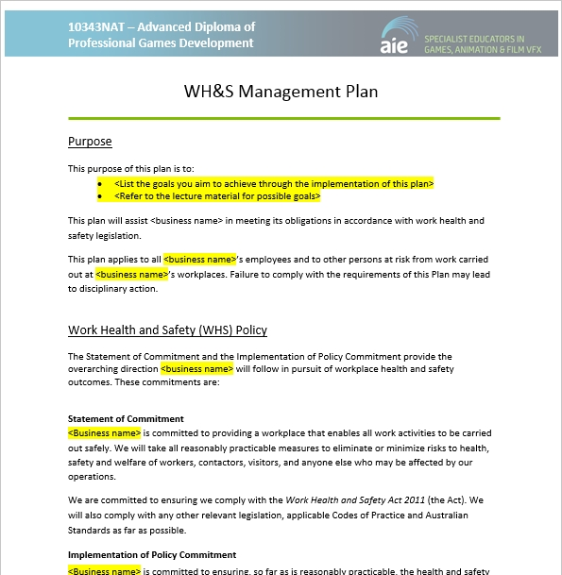
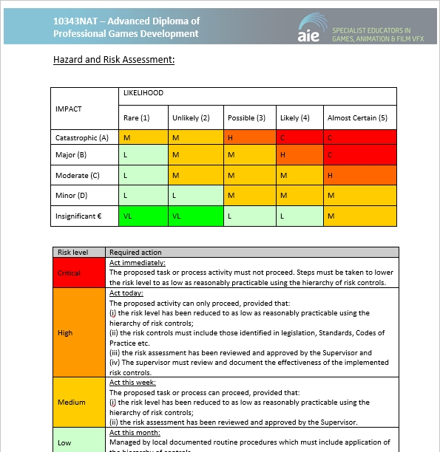
Health & Safety|WHS Management Plan
Utilising the above scenario complete all sections of the provided WHS management plan.

Slide 6
Task|Submission
The following files Must be uploaded to the assessment drive (A:) on the AIE network. Create the file structure in your locker on L: drive, have your teacher check it and then copy it across to the Assessment drive. No files can be modified on the assessment drive.
WHS Management Plan:
The WHS Management plan Must be submitted to BOTH canvas and the assessment drive (A:) on the AIE network.
01_HealthAndSafety_WHSManagementPlan.doc
Presentation:
The Assessment Powerpoint Must be submitted to BOTH canvas and the assessment drive (A:) on the AIE network.
01_HealthAndSafety_YourName.pptx

